Slide 1
Micro Credit Defaulter Project
Submitted by : Bhushan Kumar Sharma
Designation: Intern Data Scientist
Company : Flip Robo Technologies

Slide 2
Overview
A Microfinance Institution (MFI) is an organization that offers financial services to low income populations. MFS becomes very useful when targeting especially the unbanked poor families living in remote areas with not much sources of income. The Microfinance services (MFS) provided by MFI are Group Loans, Agricultural Loans, Individual Business Loans and so on.
Many microfinance institutions (MFI), experts and donors are supporting the idea of using mobile financial services (MFS) which they feel are more convenient and efficient, and cost saving, than the traditional high-touch model used since long for the purpose of delivering microfinance services. Though, the MFI industry is primarily focusing on low income families and are very useful in such areas, the implementation of MFS has been uneven with both significant challenges and successes. Today, microfinance is widely accepted as a poverty-reduction tool, representing $70 billion in outstanding loans and a global outreach of 200 million clients.
We are working with one such client that is in Telecom Industry. They are a fixed wireless telecommunications network provider. They have launched various products and have developed its business and organization based on the budget operator model, offering better products at Lower Prices to all value conscious customers through a strategy of disruptive innovation that focuses on the subscriber.
They understand the importance of communication and how it affects a person’s life, thus, focusing on providing their services and products to low income families and poor customers that can help them in the need of hour.

Slide 3
Problem Statement
A Microfinance Institution (MFI) is an organization that offers financial services to low income populations. MFS becomes very useful when targeting especially the unbanked poor families living in remote areas with not much sources of income. The Microfinance services (MFS) provided by MFI are Group Loans, Agricultural Loans, Individual Business Loans and so on.
Many microfinance institutions (MFI), experts and donors are supporting the idea of using mobile financial services (MFS) which they feel are more convenient and efficient, and cost saving, than the traditional high-touch model used since long for the purpose of delivering microfinance services. Though, the MFI industry is primarily focusing on low income families and are very useful in such areas, the implementation of MFS has been uneven with both significant challenges and successes.
Today, microfinance is widely accepted as a poverty-reduction tool, representing $70 billion in outstanding loans and a global outreach of 200 million clients.

Slide 4
We are working with one such client that is in Telecom Industry. They are a fixed wireless telecommunications network provider. They have launched various products and have developed its business and organization based on the budget operator model, offering better products at Lower Prices to all value conscious customers through a strategy of disruptive innovation that focuses on the subscriber.
They understand the importance of communication and how it affects a person’s life, thus, focusing on providing their services and products to low income families and poor customers that can help them in the need of hour.
They are collaborating with an MFI to provide micro-credit on mobile balances to be paid back in 5 days. The Consumer is believed to be defaulter if he deviates from the path of paying back the loaned amount within the time duration of 5 days. For the loan amount of 5 (in Indonesian Rupiah), payback amount should be 6 (in Indonesian Rupiah), while, for the loan amount of 10 (in Indonesian Rupiah), the payback amount should be 12 (in Indonesian Rupiah).
The sample data is provided to us from our client database. It is hereby given to you for this exercise. In order to improve the selection of customers for the credit, the client wants some predictions that could help them in further investment and improvement in selection of customers.

Slide 5
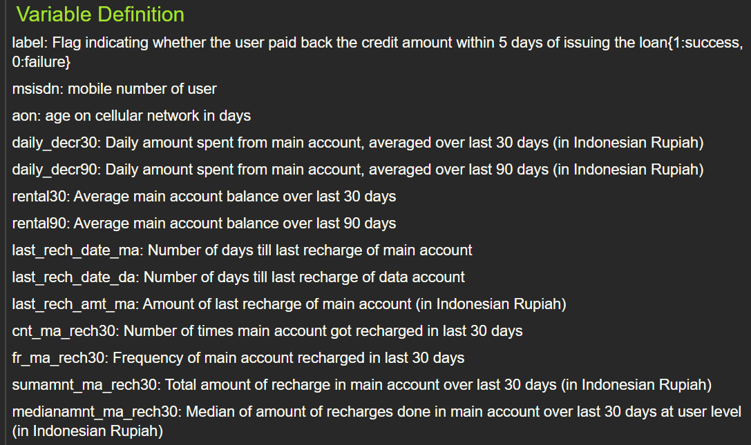
Features overview

Slide 6
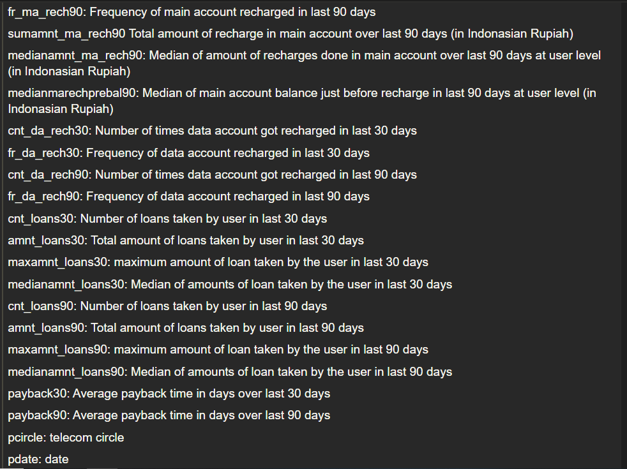

Slide 7
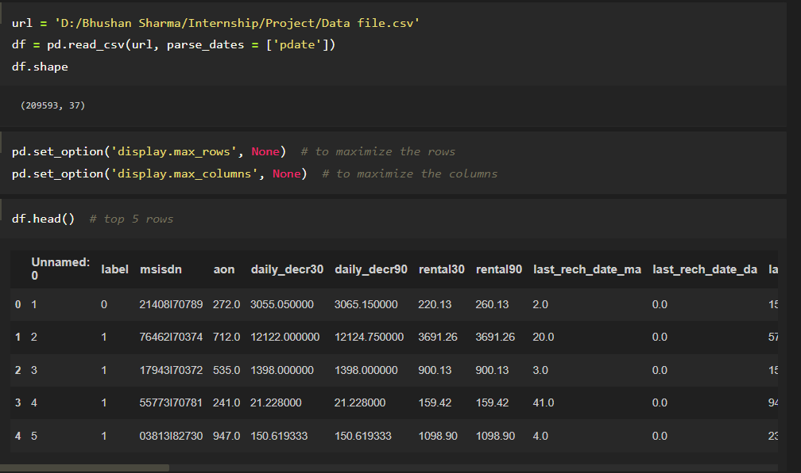
Loading dataset

Slide 8
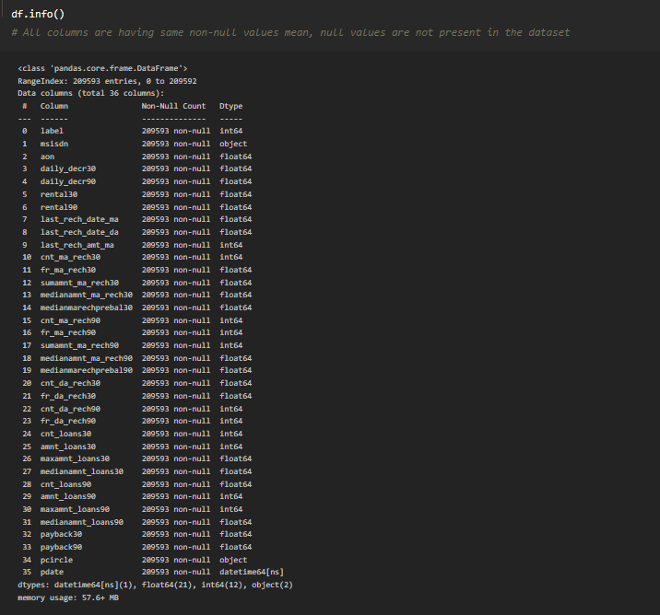
Information of dataset

Slide 9
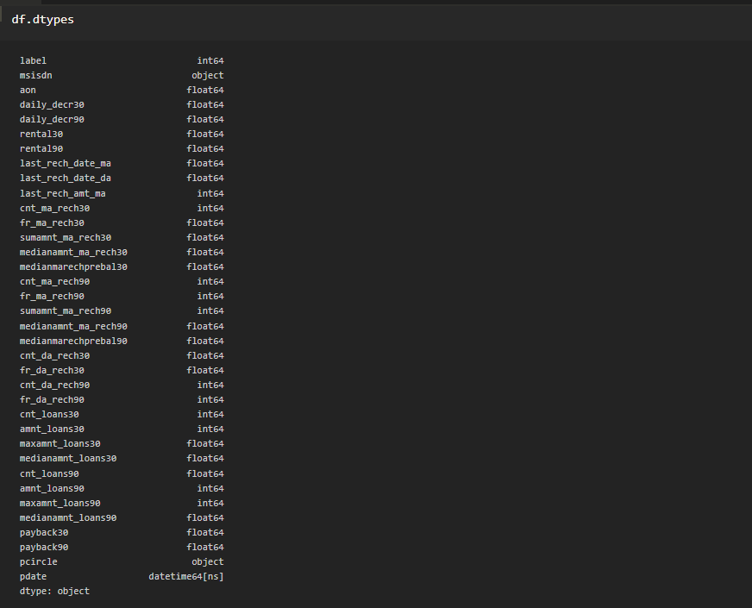
Datatype of feature

Slide 10
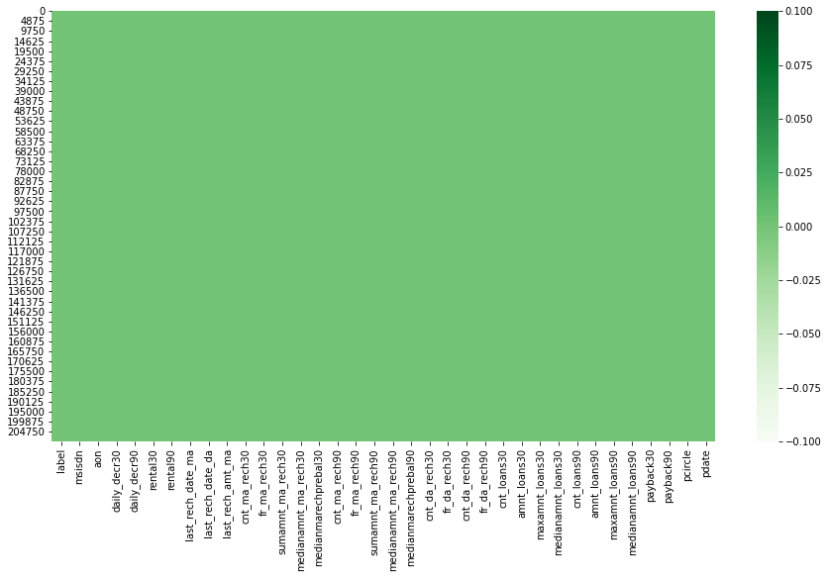
Checking null values

Slide 11
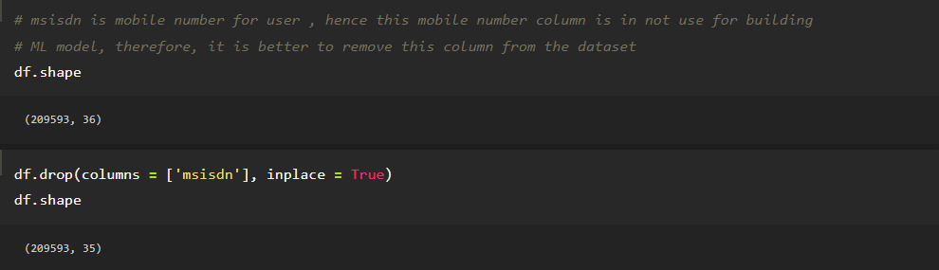
Data Preprocessing

Slide 12
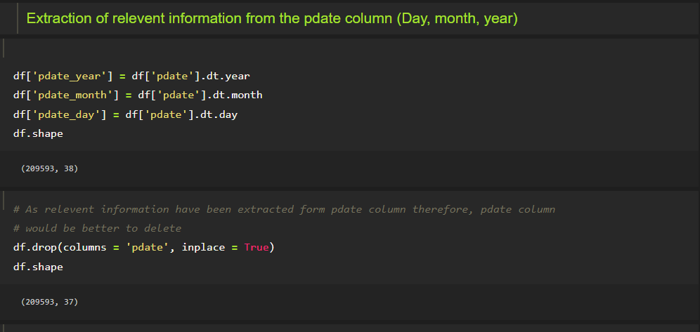
Data Preprocessing

Slide 13
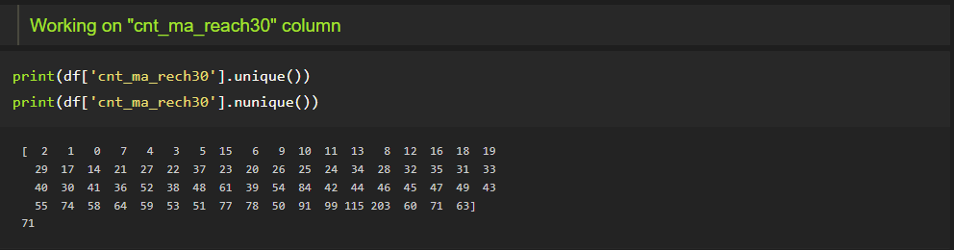
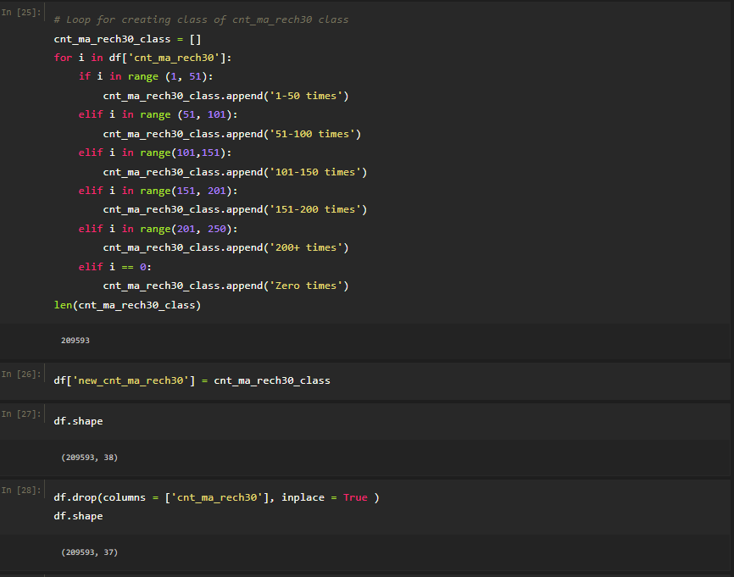

Slide 14
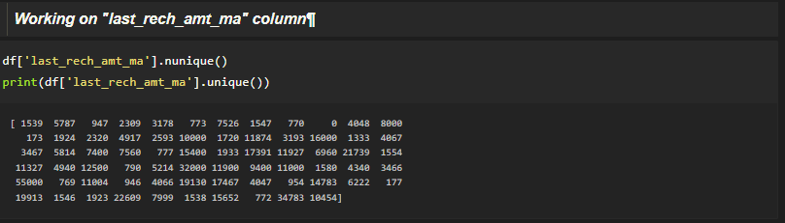
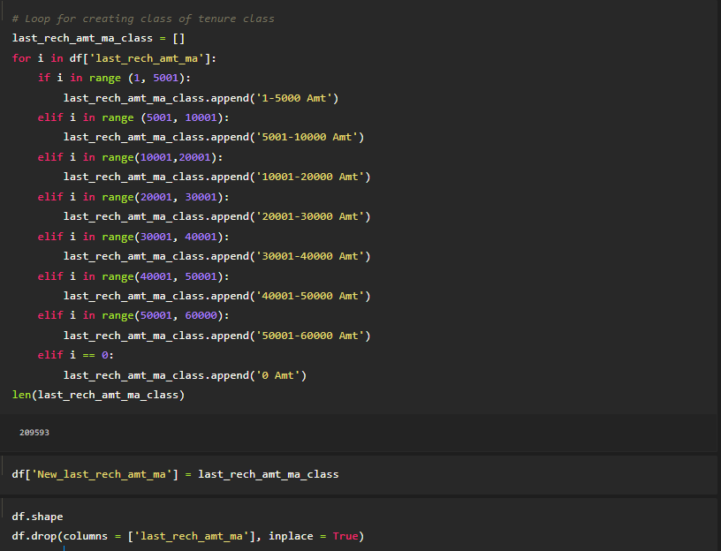

Slide 15
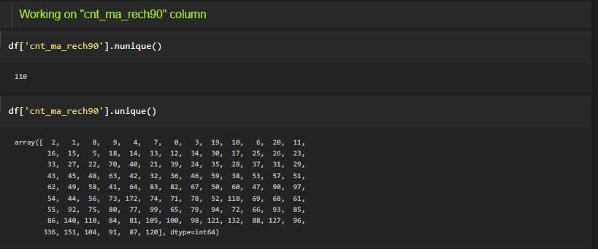
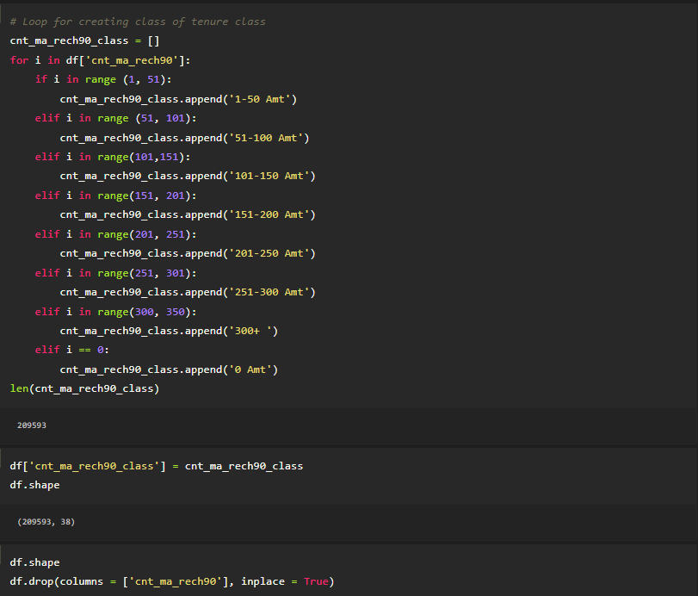

Slide 16
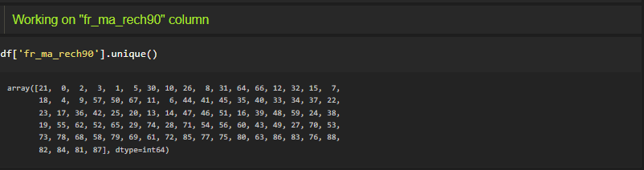
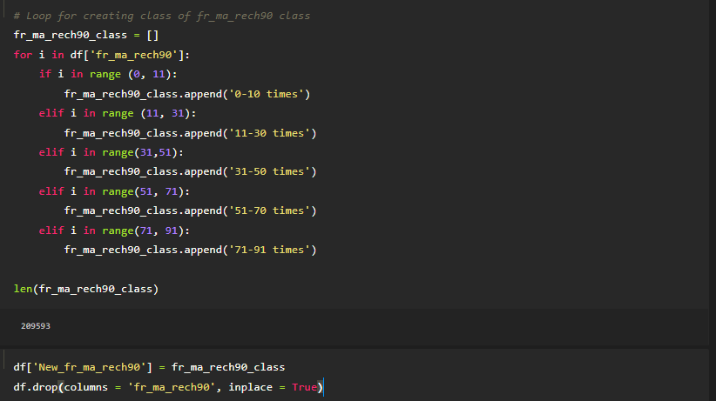

Slide 17
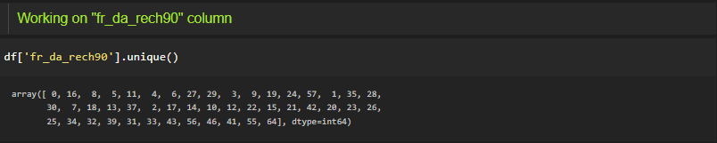
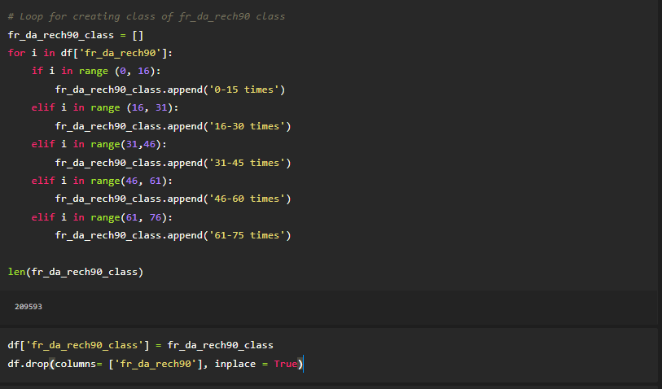

Slide 18
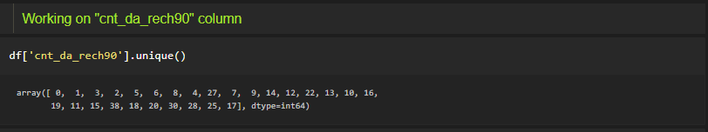
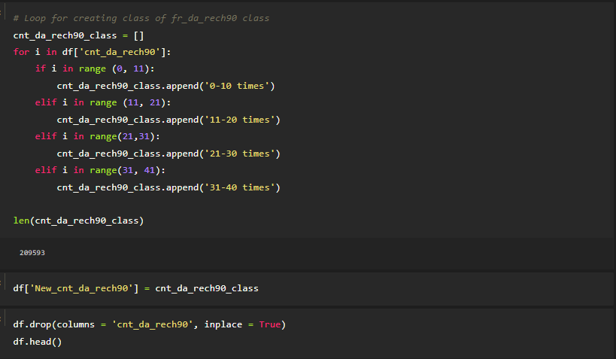

Slide 19
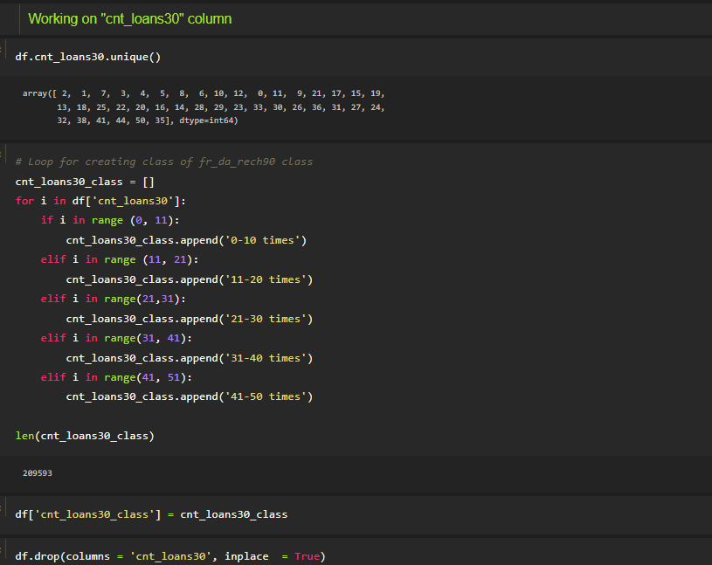

Slide 20
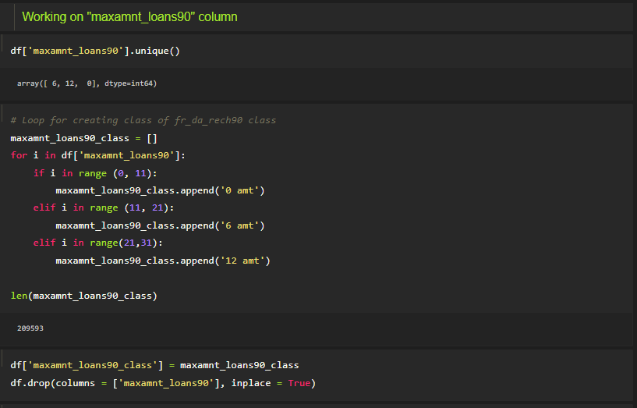

Slide 22
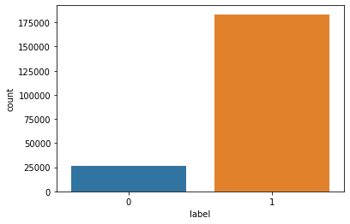
Bar Graph for variables
As we can see, Label o and label 1 records are not same, means data is imbalanced,
Need to apply SMOTE technique onto it for balance this dataset

Slide 23
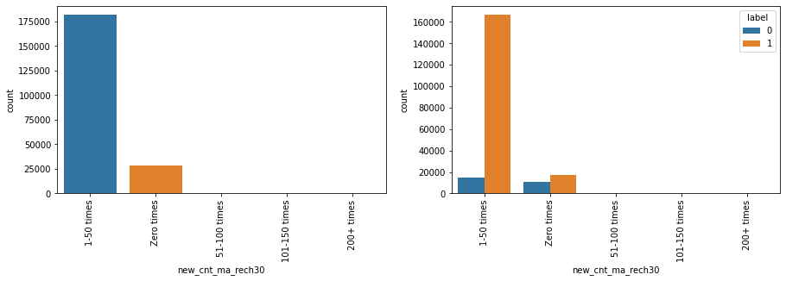
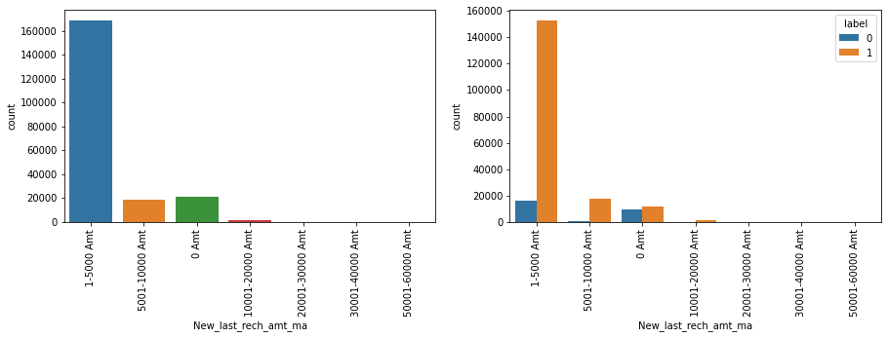

Slide 24
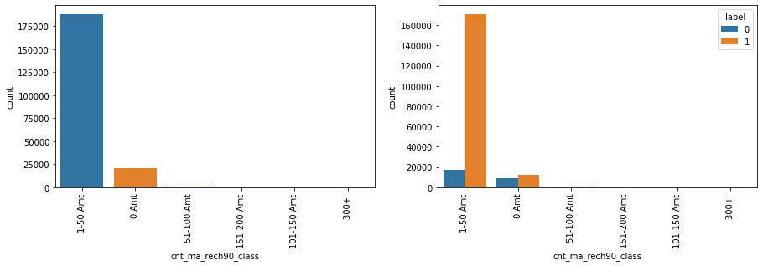
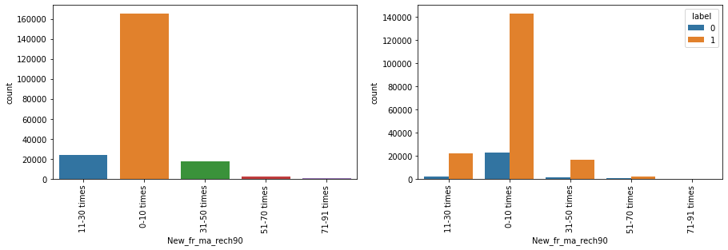

Slide 25
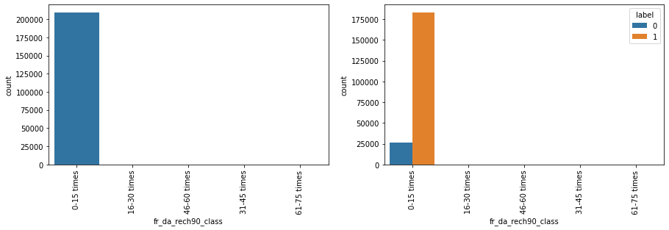
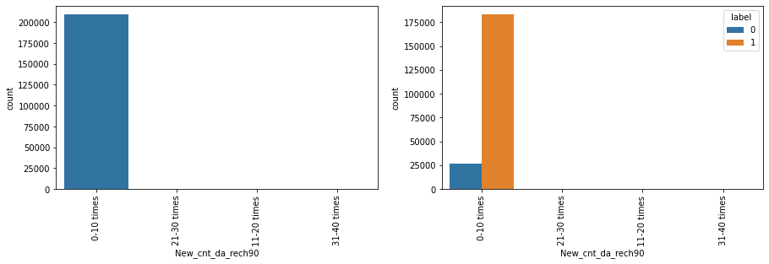

Slide 26
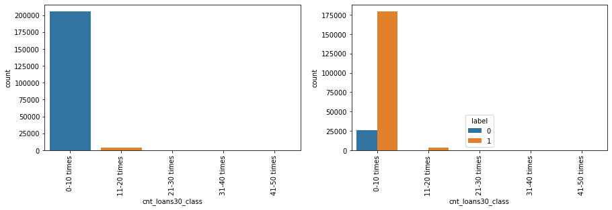
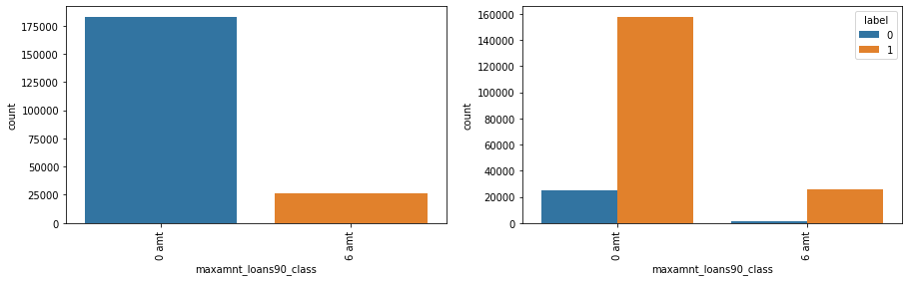

Slide 27
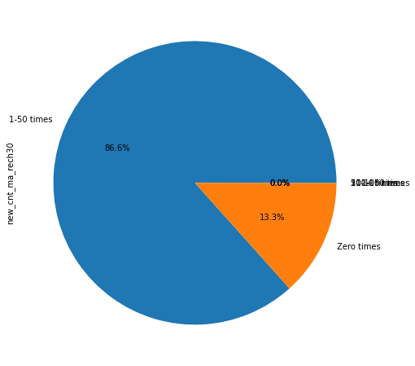
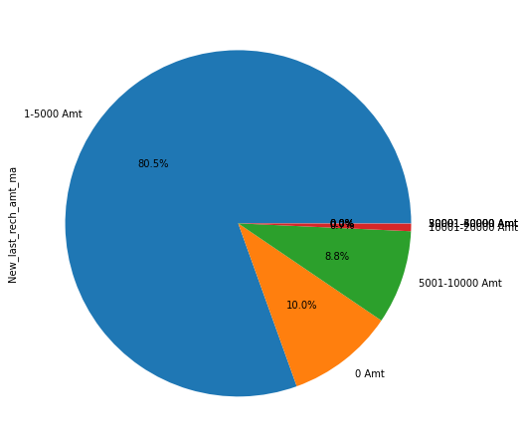
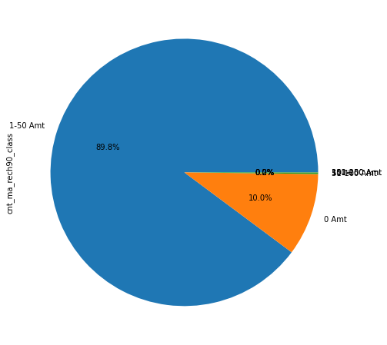
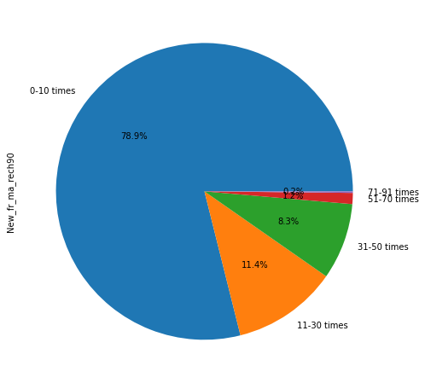
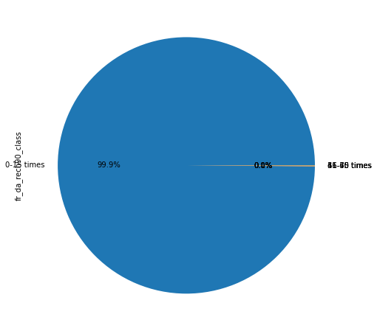
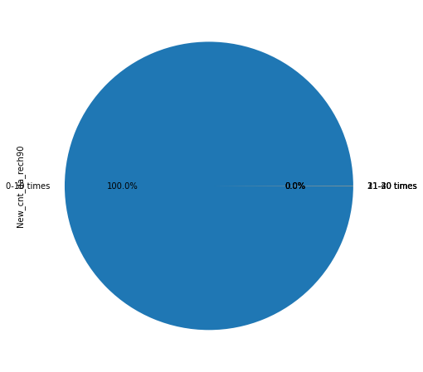
Pie Chart for variables

Slide 28
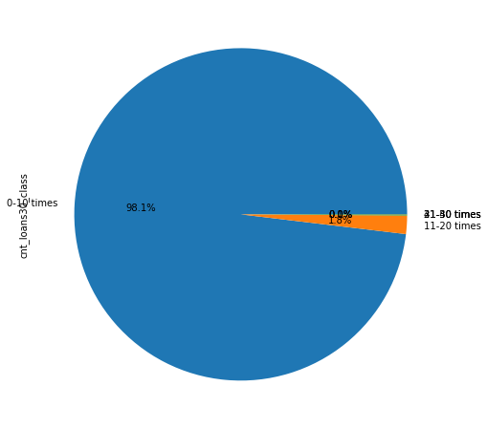
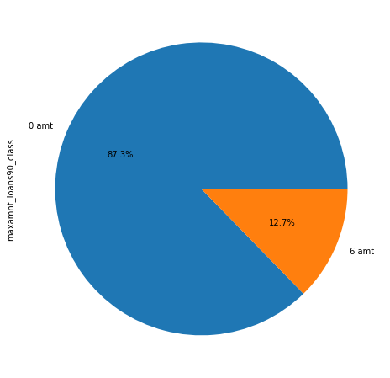
Pie Chart for variables

Slide 29
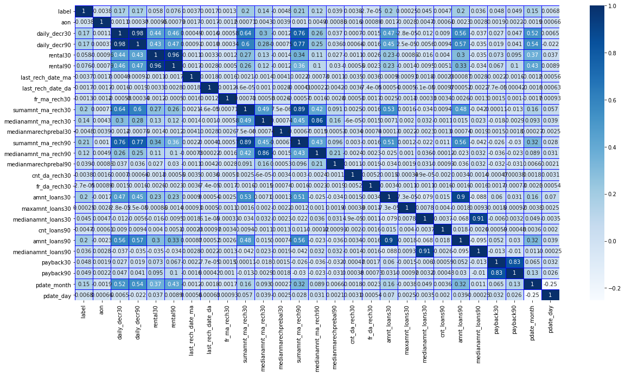
Correlation of columns

Slide 30
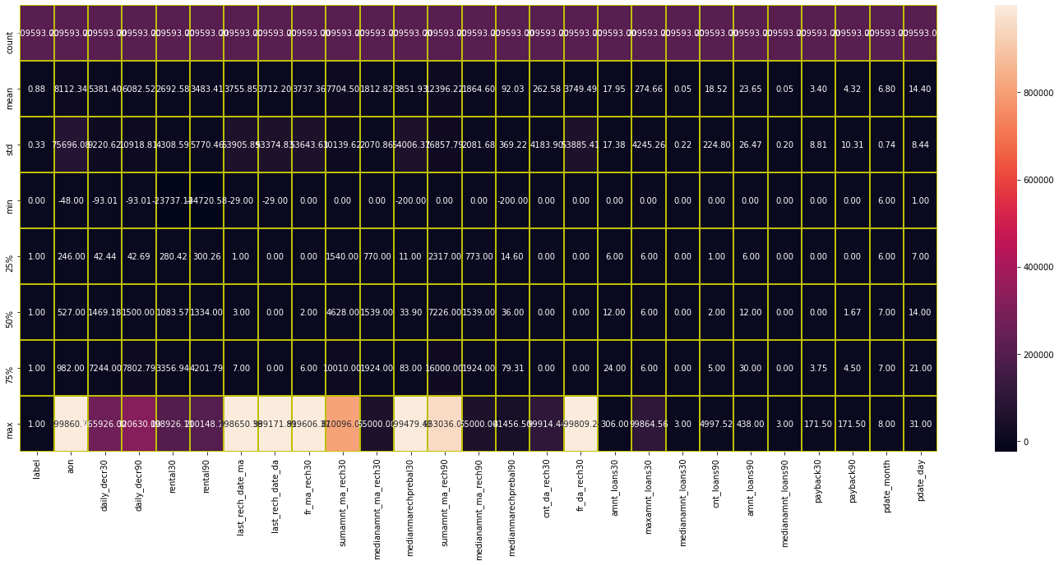
Describe Dataset

Slide 31
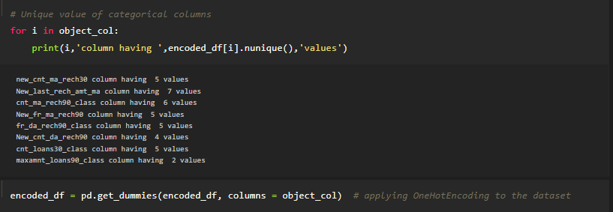
Applied Encoding

Slide 32
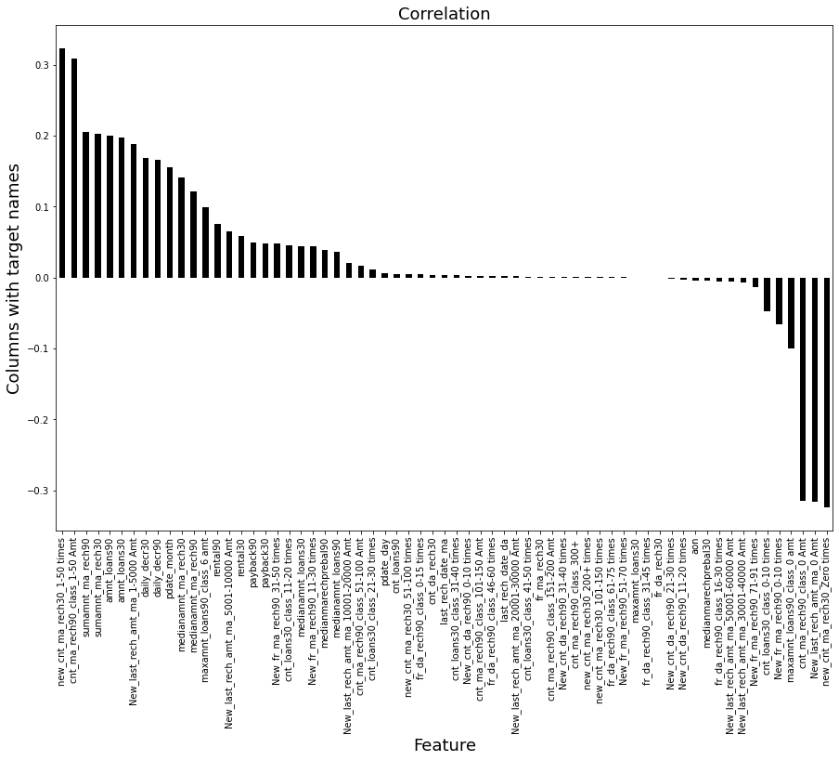
Impact of Target variable

Slide 33
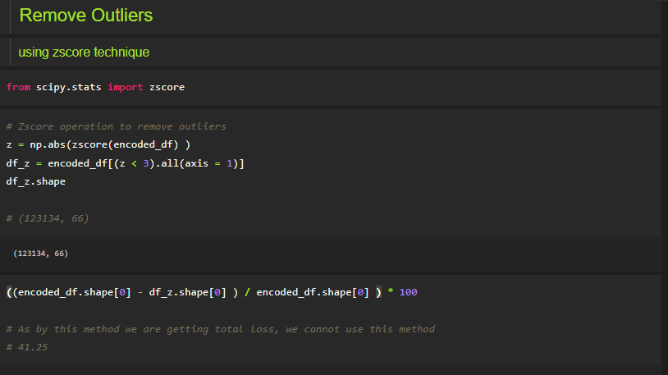
Outliers not remove due to heavy loss

Slide 34
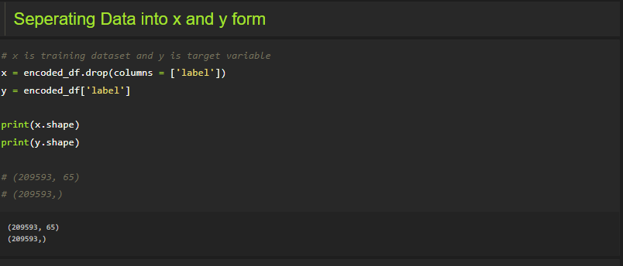
Separating data into x and y form

Slide 35
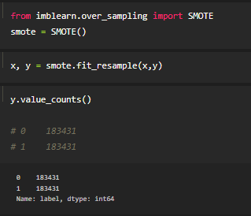
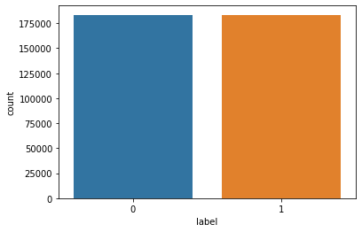
Applied SMOTE technique to x data
Before
After

Slide 36
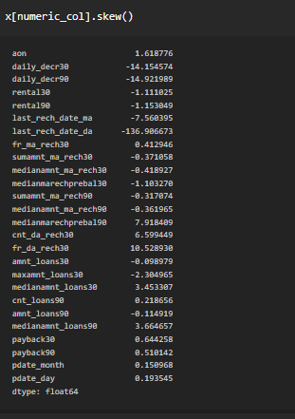
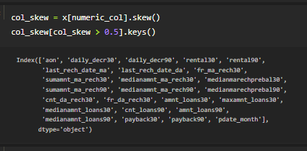
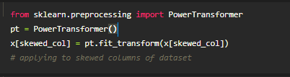
Removing Skewness
Skewness removed almost for every column
I have applied many skewness removing operation but this Powertransformer method is giving best result

Slide 37

Multicollinearity
Function to check multicollinearity between columns of dataset
Variance_inflation_factor is imported from statsmodels library of python

Slide 38



Multicollinearity
VIFs in third step are showing values which are in acceptable range,
This process have removed two columns, sumamnt_ma_rech30, daily_decr90

Slide 39

Applied Standard Scaling
VIFs in third step are showing values which are in acceptable range,
This process have removed two columns, sumamnt_ma_rech30, daily_decr90

Slide 40

Machine learning
These libraries had used for performing Machine Learning operation,
ML_Model function is created for smooth operation of machine learning

Slide 41


Machine learning
Logistic Model
ML_Model function is created for smooth operation of machine learning
Logistic Model performance
Accuracy of Training and testing are same, and cv score value is very close to accuracy of model
AUC_Score is also showing near value to accuracy

Slide 42

AdaBoostClassifier Model
This model is also performing well as it is giving almost same value for CV score and accuracy of model.

Slide 43

DecisionTreeClassifier
This model is giving highest accuracy but showing difference between accuracy of train and test dataset.

Slide 44

GradientBoostingClassifier
This model is giving second highest value of accuracy and having almost same value of cv and model accuracy.

Slide 45

Ensemble Technique of GradientboostingClassifier
As in above output, we can see, GradientBoostingClassifier is performing best as compare to other ML model,
Its cv value is also very close to accuracy of model, and it is also giving AUC-ROC Score 0.90
Hence we will apply hyper parameter tuning for GradientBoostClassifier to increase the accuracy of model

Slide 46

Ensemble Technique of GradientboostingClassifier

Slide 47

As we can after applying this hyper parameter tuning cv score is increase by some narrow change.
therefore, Gradient Boost with no parameter is giving more good result as compare to after applying ensemble

Slide 48

Final Model (GradienTboosting)
As per operation, found that GradientBoosting model is giving best result as compare to other applied models, hence this model finalize as final model
This is also giving good result we can see in above output

Slide 49

AUC-ROC Curve
Model is giving AUC_ROC value of 0.90
As value is 0.90 therefore, curve is not full sharp
Area which is covered under the shape is actually a accuracy rate
This model is having almost same value of AUC_ROC and CV

Slide 50

Deploy and load model
Deployed model by using pickle library of python
After deploying the model same model imported and checked accuracy of that same model and found model is giving 0.90 accuracy as previous.
Means deploy process is successfully executed

Slide 51

Conclusion
Comparing some value of actual dataset with predicted value by model

Slide 52
Thanks you

